Slide 1
159302
159.302 Tips for Assignment #1
Search Algorithms

Slide 2
Several Algorithms and their variants
pds_visited_list
pds_nonstrict_visited_list
best_first_no_visited_list
best_first_visited_list
A* with the Strict Expanded List (h=MisplacedTiles)
A* with the Strict Expanded List (h= Sum of Manhattan distances)

Slide 3
Algorithm Experiments
Test all algorithms on the given 5 Start & Goal states.
Tabulate the results in an Excel file (for submission).
Compare the algorithms’ performance.
Use the given batch files to run the experiments.
Run the algorithms until:
a solution is found/Q turned empty
the program ran out of memory
Optional enhancements (to get some Bonus marks)
Excess bonus marks will be added to total final marks.
Original Hash function & correct usage to speed-up the Visited List and Expanded List.

Slide 4
8-Puzzle
Start-up codes for Assignment #1 (2020)

Slide 5
SEARCH
Start-up Codes (2020)
The start-up system is comprised of multiple files.
Main.exe : Main.o graphics.o puzzle.o algorithm.o
g++ -std=c++11 -o Main.exe Main.o graphics2.o puzzle.o algorithm.o -l gdi32 -static-libgcc -static-libstdc++
Main.o : Main.cpp graphics2.h puzzle.h algorithm.h
g++ -std=c++11 -c -Wno-write-strings Main.cpp
puzzle.o : puzzle.cpp puzzle.h
g++ -std=c++11 -c -Wno-write-strings puzzle.cpp
algorithm.o : algorithm.cpp algorithm.h
g++ -std=c++11 -c -Wno-write-strings algorithm.cpp
graphics2.o : graphics2.cpp graphics2.h
g++ -std=c++11 -c -Wno-write-strings graphics2.cpp
clean:
del *.o
del *.exe
Must be preceded by a tab.
The program requires that you “build” it using a makefile.
(Ctrl+F7 for ScITE)
Notes:
-static-libgcc or -static-libstdc++, to avoid run-time dependencies on libgcc or libstdc++
http://www.mingw.org/category/wiki/gcc DLLs

Slide 6
SEARCH
Start-up Codes
Place your algorithm implementations inside algorithm.cpp
Include the function prototypes inside algorithm.h (already pre-defined)
algorithm.cpp algorithm.h
#include "algorithm.h"
using namespace std;
////////////////////////////////////////////////////////////////////////////////////////////
// Search Algorithm: A* using the Strict Expanded List
////////////////////////////////////////////////////////////////////////////////////////////
string aStar_ExpandedList (string const initialState, string const goalState, int &numOfStateExpansions, int& maxQLength, float &actualRunningTime, int &numOfDeletionsFromMiddleOfHeap, int &numOfLocalLoopsAvoided, int &numOfAttemptedNodeReExpansions,
heuristicFunction heuristic ){
// put your implementation codes here…
}
This is to avoid writing a cluttered program. The batch files also rely on specific algorithm names as parameters
Skeleton functions are provided in the start-up codes.

Slide 7
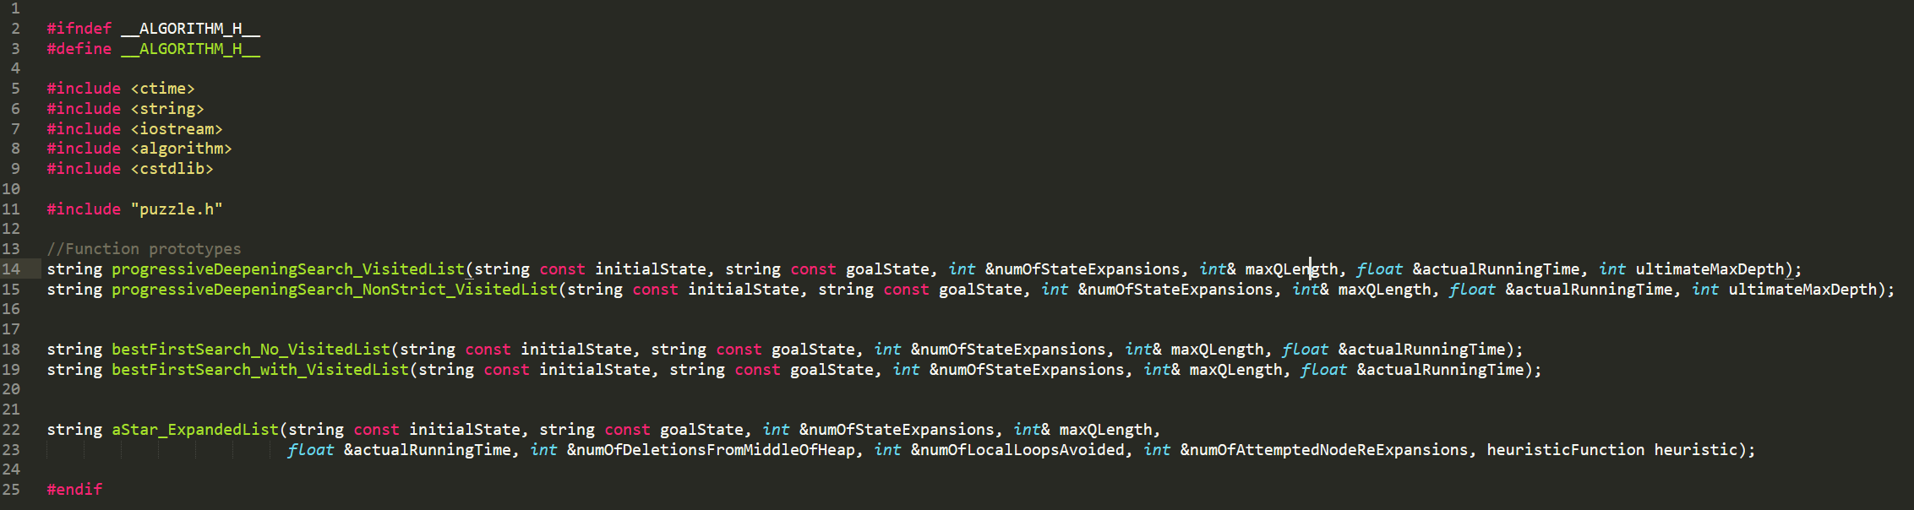
SEARCH
Start-up Codes
algorithm.h
You are not allowed to change the names and formal parameters of the algorithms. The batch files refer to them to automate the execution of experiments.

Slide 8
SEARCH
Main function (required arguments)
The program requires 4 arguments.
int main( int argc, char* argv[ ] ){
string path;
cout << "=========<< SEARCH ALGORITHMS >>=========" << endl;
if(argc < 5){
cout << "SYNTAX: main.exe <TYPE_OF_RUN = \"batch_run\" or \"single_run\"> ALGORITHM_NAME \"INITIAL STATE\" \"GOAL STATE\" " << endl;
…
…
}

Slide 9
SEARCH
Main function (required arguments)
The program requires 4 arguments.
int main( int argc, char* argv[ ] ){
string path;
cout << "=========<< SEARCH ALGORITHMS >>=========" << endl;
if(argc < 5){
cout << "SYNTAX: main.exe <TYPE_OF_RUN = \"batch_run\" or \"single_run\"> ALGORITHM_NAME \"INITIAL STATE\" \"GOAL STATE\" " << endl;
…
…
}
Running the program:
Algorithm name
INITIAL STATE GOAL STATE
Example:
main.exe "batch_run" “astar_explist_manhattan" "042158367" "012345678"
type of run = "batch_run" or "single_run"
Batch files are provided to run all the experiments.
Batch_run – for tabulation of results (run_all.bat)
Single_run – for animated solution (run_one.bat)

Slide 10
SEARCH
Main function (required arguments)
Running the program:
Algorithm name
INITIAL STATE GOAL STATE
Example:
main.exe "batch_run" “astar_explist_manhattan " "042158367" "012345678"
type of run = "batch_run" or "single_run"
Batch_run – for tabulation of results (run_all.bat)
Single_run – for animated solution (run_one.bat)
Algorithm name (you are not allowed to change these names)
"pds_visited_list"
"pds_nonstrict_visited_list"
"best_first_no_visited_list"
"best_first_visited_list"
"astar_explist_manhattan"
"astar_explist_misplacedtiles"

Slide 11
Batch files for quick testing
run_all.bat
run_one.bat

Slide 12
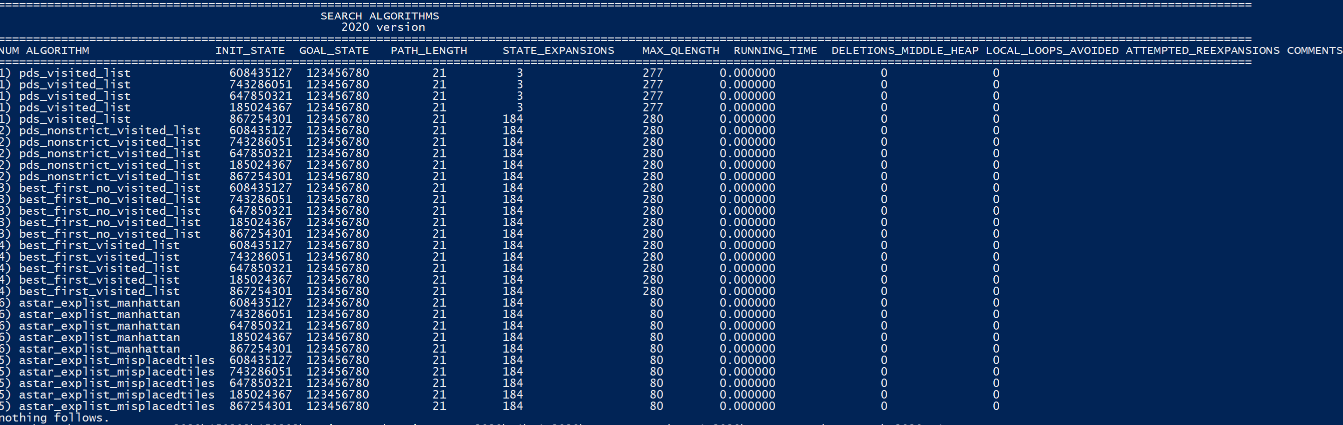
SEARCH
Batch run (run_all.bat)
Running the algorithms
Batch run
This type of run is used for running all the experiments required for all the algorithms.
Results are tabulated nicely, according to the requirements of the assignment.
Example:
Extra information to help with algorithm implementation analysis.
Convert the results from text to Excel file format. (see template.xlsx)

Slide 13
SEARCH
Batch run (run_all.bat)
Running the algorithms
main.exe "batch_run" "pds_visited_list" "042158367" "123804765"
main.exe "batch_run" "pds_nonstrict_visited_list" "042158367" "123804765"
main.exe "batch_run" "best_first_no_visited_list" "042158367" "123804765"
main.exe "batch_run" "best_first_visited_list" "042158367" "123804765"
main.exe "batch_run" "astar_explist_manhattan" "042158367" "123804765"
main.exe "batch_run" "astar_explist_misplacedtiles" "042158367" "123804765"
Algorithm name
INITIAL STATE GOAL STATE
Example:
main.exe "batch_run" “astar_explist_manhattan" "042158367" "123804765"
type of run = "batch_run" or "single_run"
Specific algorithm names are provided in the start-up codes to identify all the algorithms.

Slide 14
SEARCH
Animated Solution (run_one.bat)
Using graphics to show the animated solution
if(algorithmSelected == "astar_explist_manhattan" ){
path = aStar_ExpandedList(initialState, goalState, numOfStateExpansions, maxQLength, actualRunningTime, numOfDeletionsFromMiddleOfHeap,numOfLocalLoopsAvoided, numOfAttemptedNodeReExpansions, manhattanDistance);
} else if(…){
}…
…
if(typeOfRun == "single_run"){
if(path != "") {
AnimateSolution(initialState, goalState, path);
}
}
The “single_run” parameter invokes the AnimateSolution function.
An animation function is provided for you.
e.g. path=“URRDLURRDLR”
Skeleton function

Slide 15
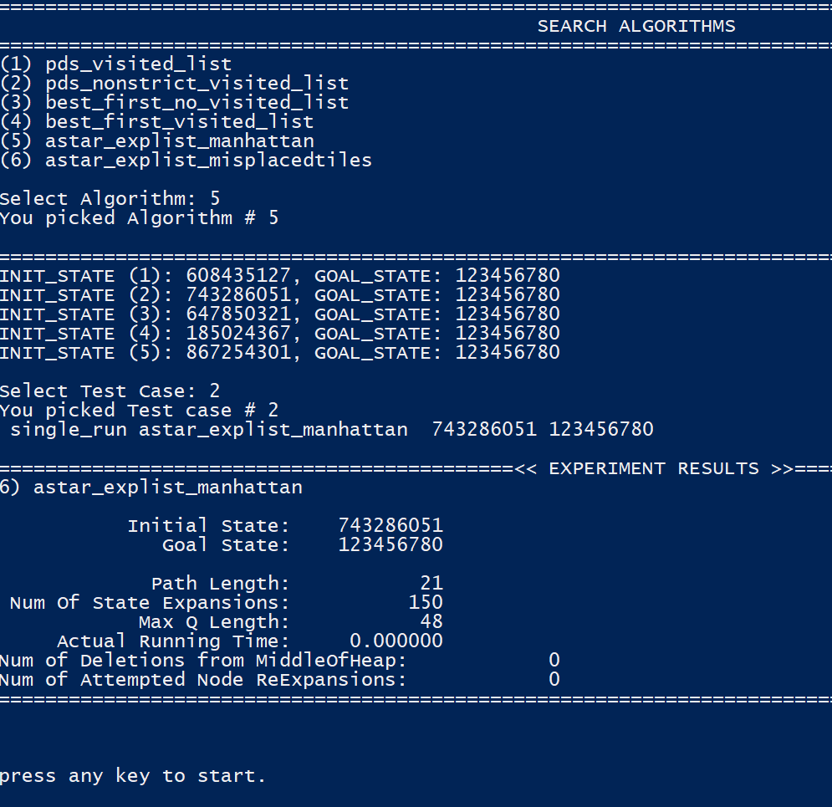
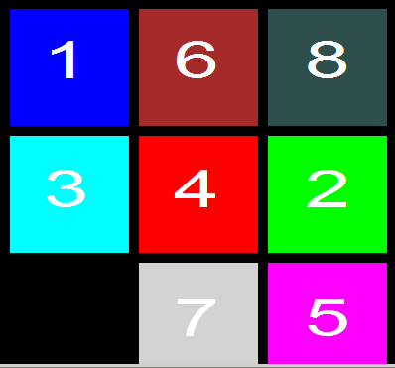
SEARCH
Animated Solution (run_one.bat)
.
Try run_one.bat

Slide 16
SEARCH
Some notes on implementing the Progressive Deepening Search
Pseudocode
C=1
Do Depth-limited DFS to max. depth C. If path is found, return it.
Otherwise, increment C and go to Step 2.

Slide 17
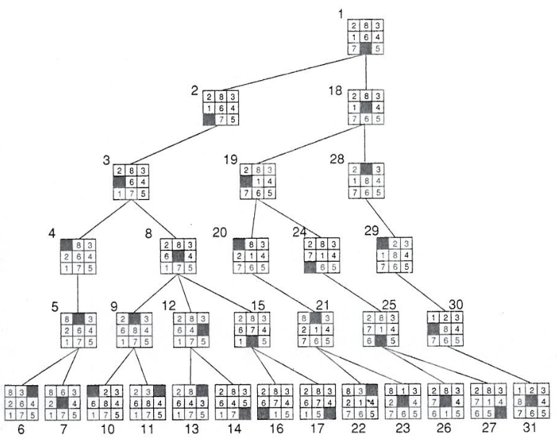
Example: Depth-limited Depth-First Search
start
Successor generator: Left, Up, Right, Down
(this is only an example. The sequence generator is different from the assignment)
The algorithm is looking for a sequence of moves that will arrange any given initial board configuration to match the goal state.
At depth bound = 5
…
…
…
goal
Note: the complete search tree is not shown here.

Slide 18
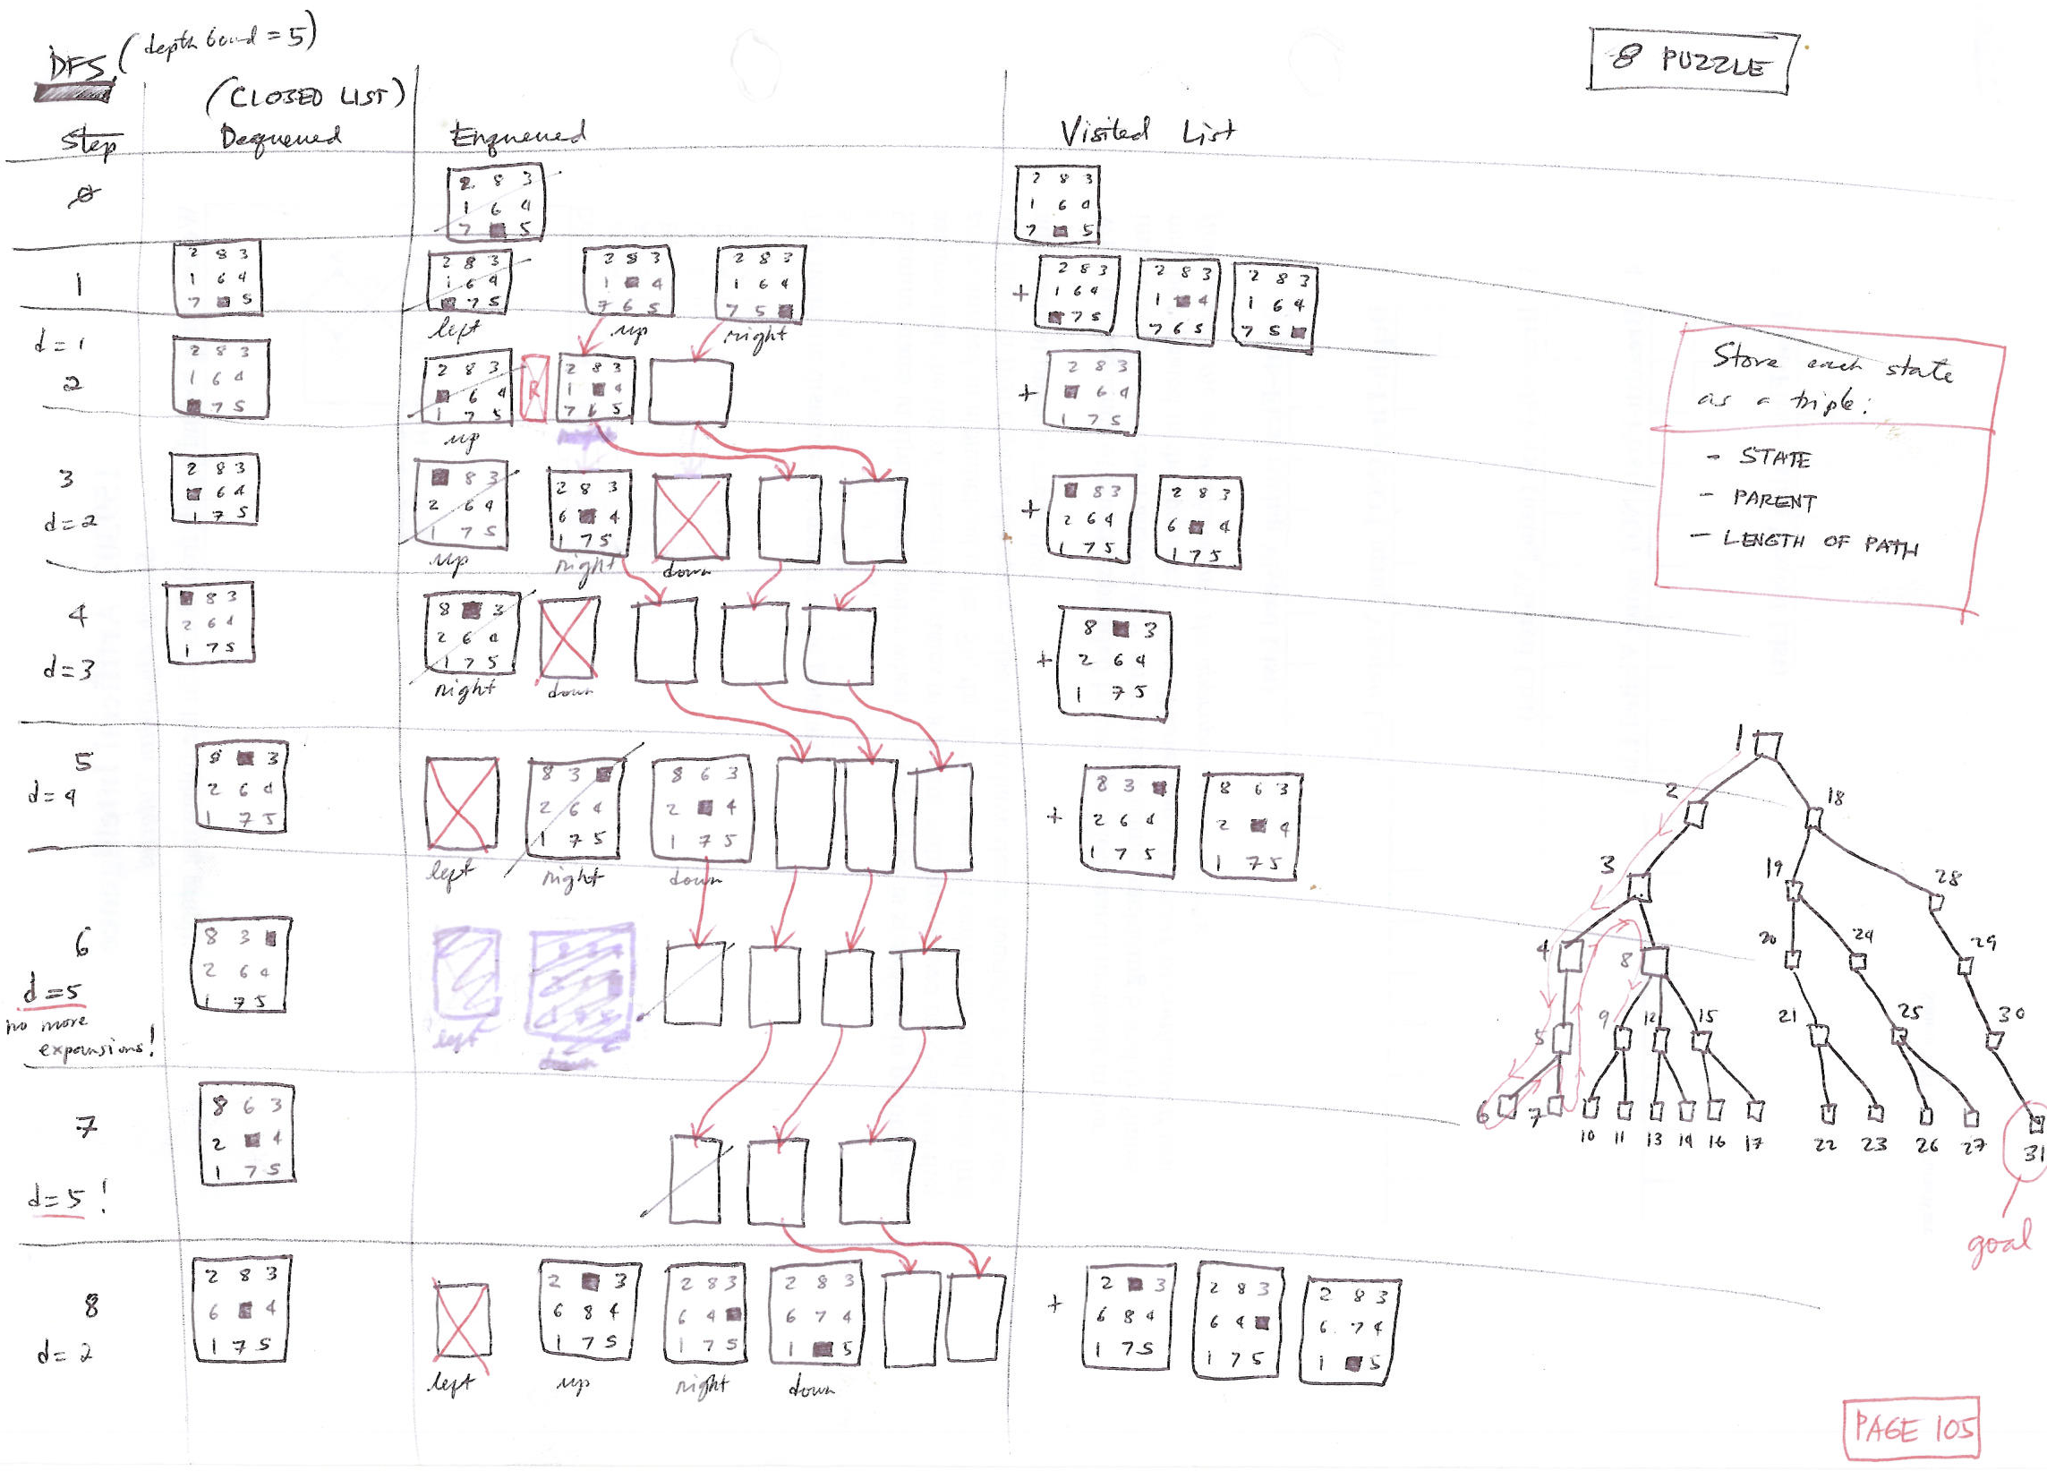
Depth-limited Depth-First Search
Successor generator: Left, Up, Right, Down

Slide 19
The states are the board configurations
6 | 2 | 8
 | 3 | 5
4 | 7 | 1
There are 9! states but not all of them are reachable from a given board position.
S
A move corresponds to moving the blank ‘0’-tile
6 | 2 | 8
 | 3 | 5
4 | 7 | 1
The successors of a state are to be generated in a FIXED order, to be drawn from left to right, namely move the blank tile: Down, Right, Up, then Left.
Down
Right
Up
Left
6 | 2 | 8
4 | 3 | 5
 | 7 | 1
6 | 2 | 8
3 |  | 5
4 | 7 | 1
 | 2 | 8
6 | 3 | 5
4 | 7 | 1

Slide 20
class Puzzle
In the start-up codes, I am providing a class named Puzzle to give the class some clue on how to approach the problem using an object-oriented programming style.
The class Puzzle is not complete, if you intend to use it in your assignment, you will have to fill-in the missing functions.
void Puzzle::updateFCost(){
//fCost = ?
}
//Heuristic function implementation
int Puzzle::h(heuristicFunction hFunction){
int sum=0;
int h=0;
int numOfMisplacedTiles=0;
switch(hFunction){
case misplacedTiles:
//place your implementation here
//h = ??? //numOfMisplacedTiles;
break;
case manhattanDistance:
//place your implementation here
//h = ??? //sum of manhattan distance;
break;
};
return h;
}
Note that it is not required to use the class Puzzle when implementing the different algorithms - you may design your own class from scratch.

Slide 21
class Puzzle
0
1
2
x
class Puzzle{
private:
string path; //moves generated (e.g. URDL..)
int pathLength;
int hCost;
int fCost;
int depth;
int goalBoard[3][3]; //goal board configuration
int x0, y0; //coordinates of the blank or 0-tile
int board[3][3]; //current board configuration
0
6 | 2 | 8
 | 3 | 5
4 | 7 | 1
1
2
//used by A*
y
1 | 2 | 3
8 |  | 4
7 | 6 | 5
Goal
Feel free to add more variables and functions that you may require.

Slide 22
Puzzle(const Puzzle &p); //constructor; creates a copy of a given puzzle
Puzzle(string const elements, string const goal); //constructor; generates 2D-array versions corresponding to an initial board configuration and a goal configuration.
void printBoard(); //prints the content of a puzzle
int h(heuristicFunction hFunction); //computes for the heuristic value of a state
void updateFCost(); //computes for the f-cost of a search node
bool goalMatch(); //returns true if the current board configuration matches the goal state; otherwise, false
bool canMoveLeft();
bool canMoveRight();
bool canMoveUp();
bool canMoveDown();
Puzzle * moveUp();
Puzzle * moveRight();
Puzzle * moveDown();
Puzzle * moveLeft();
//checks to see if the blank 0-tile could be moved in a specific direction (codes provided)
//creates an instance of a Puzzle (including memory allocation), representing the result of the move taken. It also keeps track of the sequence of moves taken (or the partial path). The function returns a Puzzle object. (codes provided)

Slide 23
Search node
Q
( )( )( )
 | 2 | 8
6 | 3 | 5
4 | 7 | 1
6 | 2 | 8
 | 3 | 5
4 | 7 | 1
6 | 2 | 8
3 |  | 5
4 | 7 | 1
6 | 2 | 8
 | 3 | 5
4 | 7 | 1
6 | 2 | 8
4 | 3 | 5
 | 7 | 1
6 | 2 | 8
 | 3 | 5
4 | 7 | 1
a Q is a container for the partial paths (search nodes) being considered for expansion.
depending on the algorithm you are implementing, you may be needing a Queue, Stack or a Priority Queue to implement this Q container.
When extending a node, moveUp(), moveRight(), moveDown(), moveLeft() comes handy.
Within a search node, there shouldn’t be any repeating nodes/no local loops allowed (i.e. you may have to add variables and test functions to do this, depending on the algorithm you are implementing).

Slide 24
SEARCH
Admissible Heuristics
8 Puzzle: Move tiles to reach goal. Think of a move as moving an “empty” tile.
6 | 2 | 8
 | 3 | 5
4 | 7 | 1
1 | 2 | 3
8 |  | 4
7 | 6 | 5
S
G
Alternative underestimates of “distance” (number of moves) to goal:
Number of misplaced tiles (7 in the example above).
Sum of Manhattan Distance of tile to its goal location (17 in example above).
Manhattan Distance between (x₁, y₁) and (x₂, y₂) is │x₁ – x₂│ and │y₁ – y₂│.
Each move can only decrease the distance of exactly one tile.
The second of these is much better at predicting actual number of moves.

Slide 25
SEARCH
Admissible Heuristics
8 Puzzle: Move tiles to reach goal. Think of a move as moving an “empty” tile.
Number of misplaced tiles
1 |  | 3
8 | 2 | 4
7 | 6 | 5
1 | 2 | 3
8 |  | 4
7 | 6 | 5
S
G
Are we supposed to include the blank tile in the counting of misplaced tiles?
No.
What will be the consequence if we include it? Examine the case above.
The heuristic will no longer be admissible. A* will miss finding the optimal solution if the heuristic is not admissible.

Slide 26
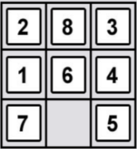
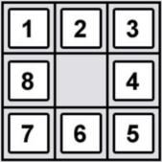
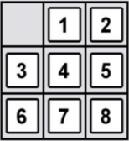
SEARCH
Hash function
A quick look-up of the status of states
Keys
Hash Values
index
e.g.
123456
false
Hash function
123457
true
Fixed length
Hash(key)
123458
true
Search Nodes
We can implement the Visited List/Expanded List using a hash table.
123459
true
.
.
.
.
.
.
A hash function could be used to map large data sets of variable length, called keys to hash values that are of a fixed length. The hash values may serve as indexes to an associative array.
However, hash values may have duplicates; therefore, may cause collision between keys.

Slide 27
SEARCH
Hash function
Visited List / Expanded List
A quick look-up of the status of states
Keys
Hash function
Hash Values
Fixed length
e.g.
000001
false
Hash()
362879
true
200000
true
Search Nodes
300879
true
.
.
.
.
.
.
.
.
.
.
.
.
Given a state, we can quickly check whether or not we have visited/expanded it previously.
362880
true
STATE

Slide 28
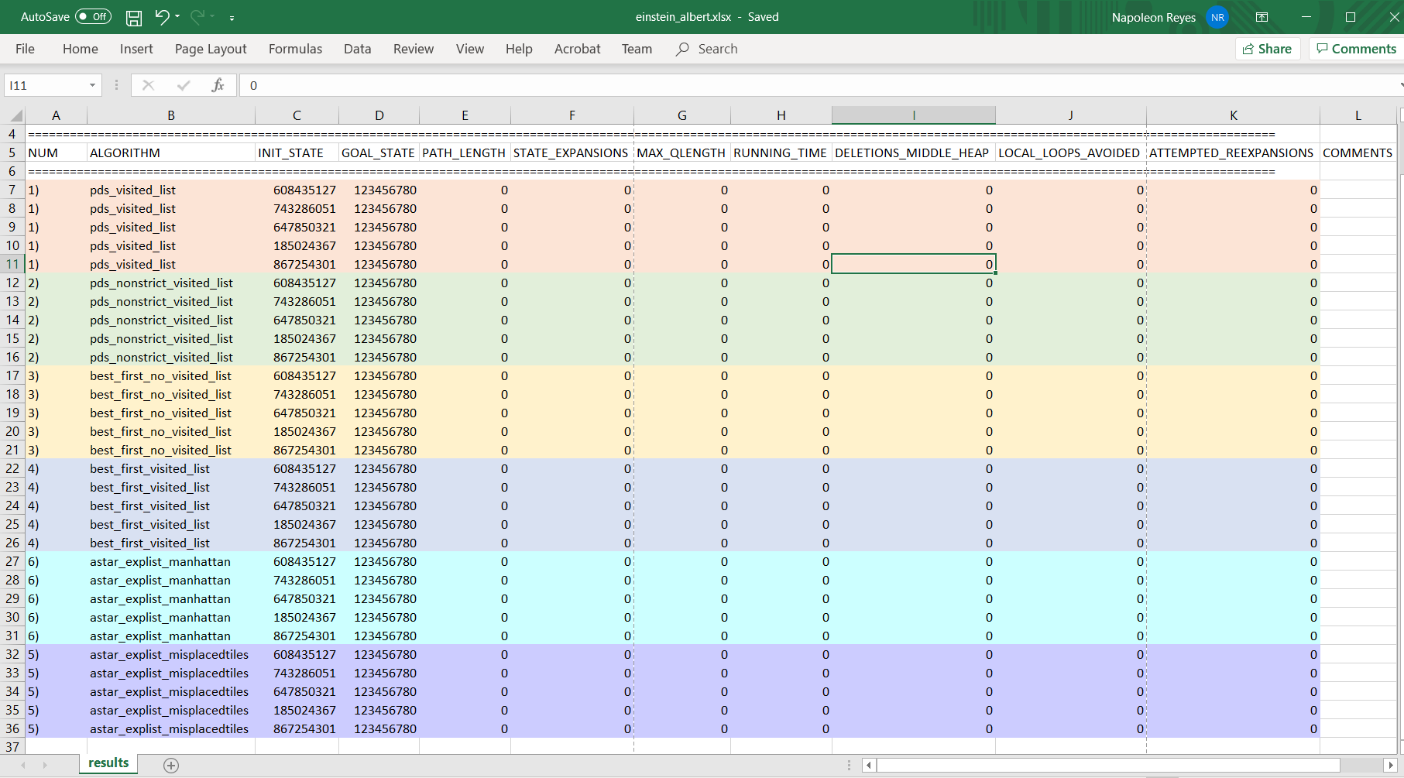
Tabulation of Experiment Results
Use your surname_forename.xlsx as the name of your Excel file
Your assignment will be marked based on the results of your experiments.
The worksheet must be named “results”
Results must be replicable using your submitted codes.

Slide 29
Marking Criteria
For each (start, goal) state combination, the following statistical measures will be used in computing the assignment marks:
path length (60% of marks)
number of state expansions (20% of marks)
max Q length (20% of marks)
For each statistical measure:
e.g. Number of state expansions:
Correct value: 5 marks
Within 10% of the correct answer: 4 marks
Within 20% of the correct answer: 3 marks
More than 20% of the correct answer: 2 marks
No answer: 0 mark

